Slide 1

The ToDoList Project
By Robert Tolley

Slide 2
What needed to be done?
Back-End
Spring ToolSuite – provide the link between the front – end and a database
Coded with Java
Front-End
JavaScript + Html
Provide a UI for to input tasks to a desired group
Notes:
The general overview for this project was two main aspects:
The back end which used Spring ToolSuite to provide a connection between the front-end and a database
And the front-end which would provide a user interface to input new tasks to a desired group

Slide 3
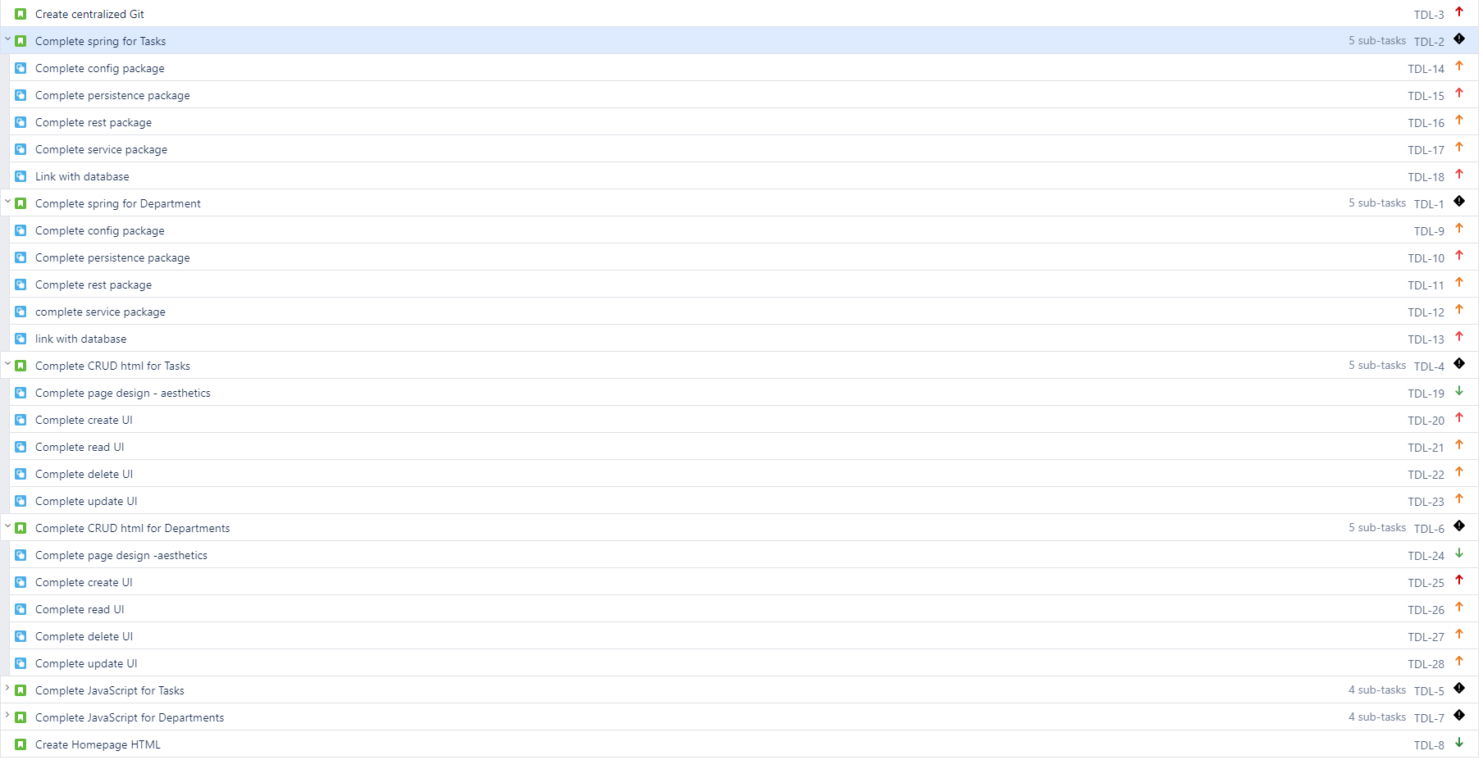
Project management
Notes:
Here you can see the first look at the Minimum viable product converted into user stories and sub groups, On the right we have the moscow methodology to show the importance of each task, black diamonds represent the larger objectives, red being the highest, then to orange then to greem.

Slide 4
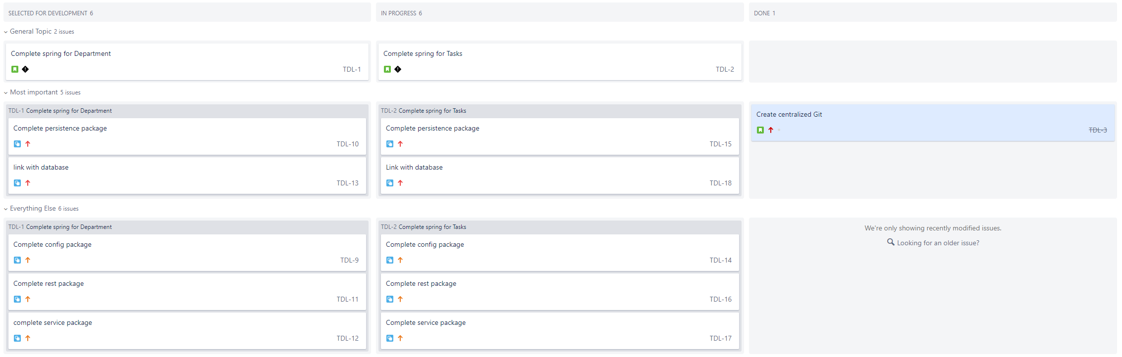
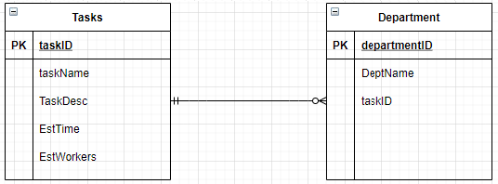
Day 1
Notes:
This is the first sprint created, starting with the first goal which is to complete spring for the tasks section, with all the requirements to do this below. That would then be followed up by working on the spring section for the department entity.
At the bottom is a basic ERD showing the values the tasks domain and the department domain would have.

Slide 5
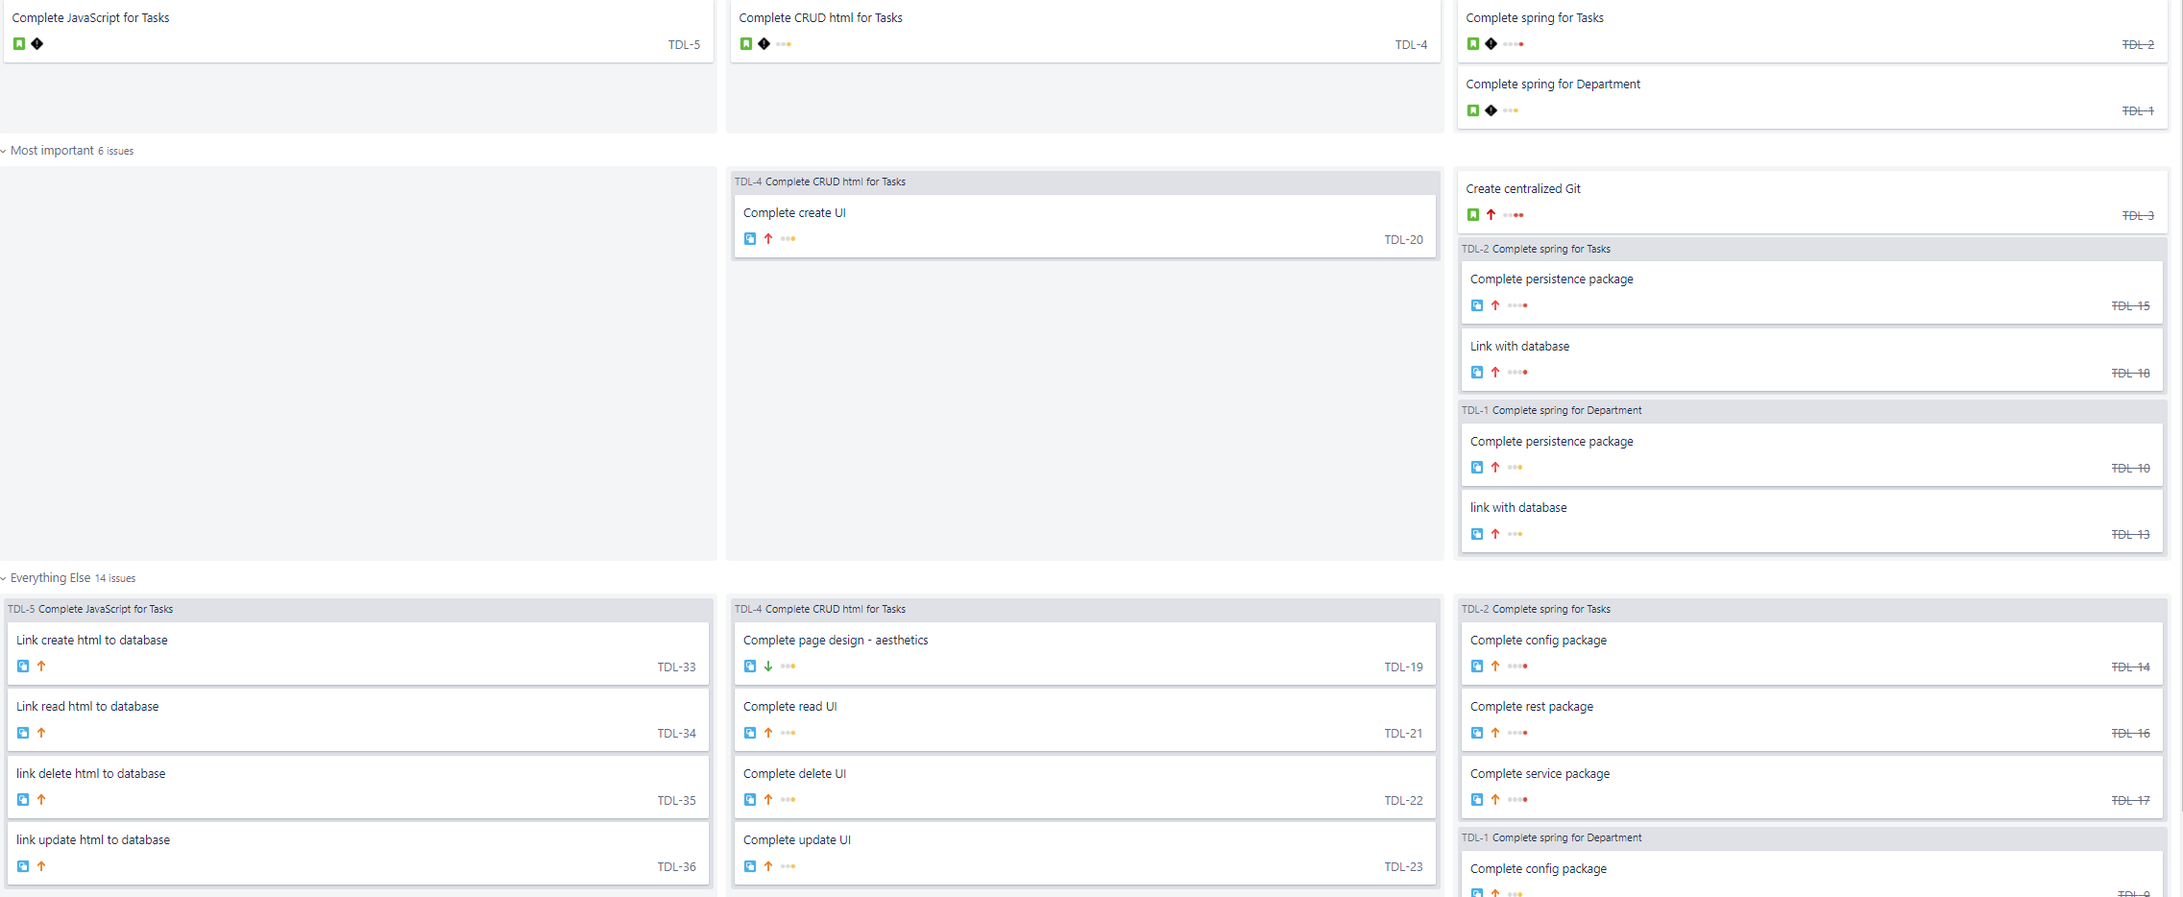
First sprint for html
Notes:
Moving onto the html sprint, I began working on the crud functionality for tasks first, once the html code was completed for this, I would then move onto working with the javascript for the task section, ensuring tasks was fully up and functional before working on departments

Slide 6
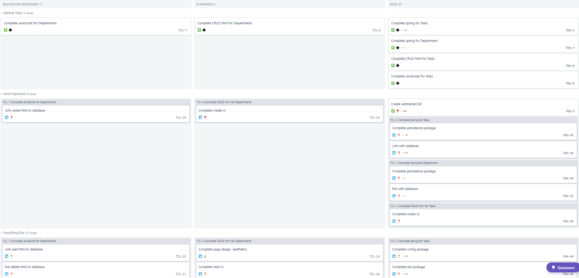
Final sprint
Notes:
Here we have my final sprint for the mvp, which would be working on both the html and javascript for departments, this wasn’t much different to the tasks as all the backend was already completed which would bring forth all the information and links between the two entities when requested.

Slide 7
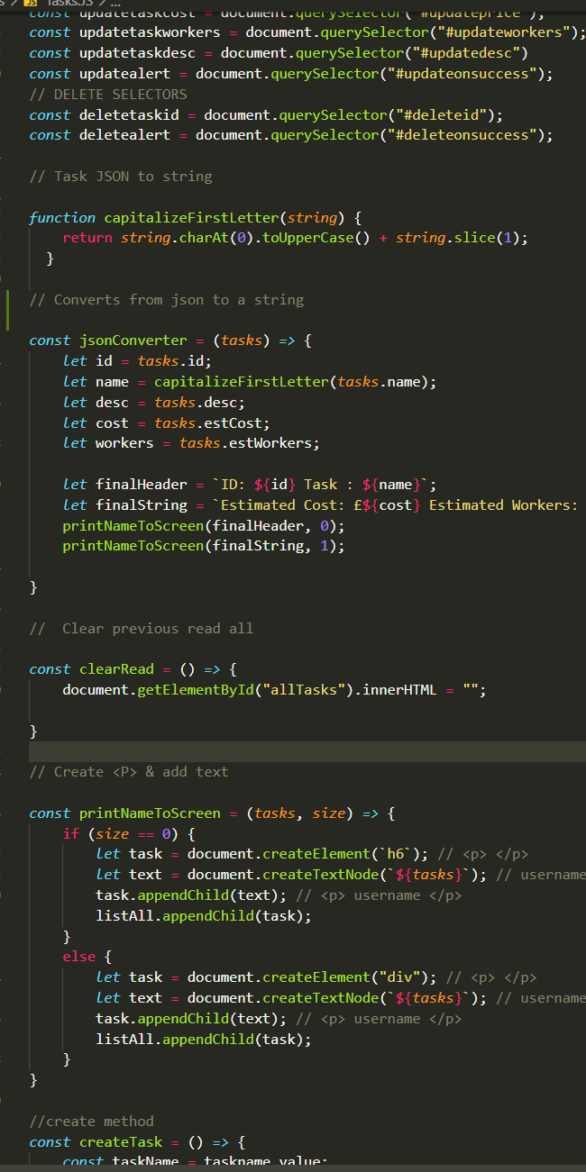
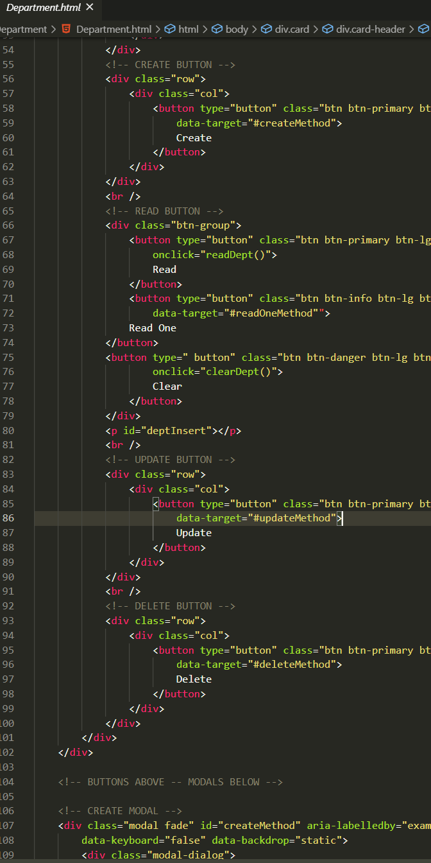
New technologies used
Spring
Html + Javascript
BDD
Sonarqube
Selenium – Automated testing
Notes:
These are some of the new technologies and techniques I have learnt and developed during this project, Spring being the main foundation for my back-end, html and javascript for the front end.
On the right you can see them, as well as implementation of behavior driven development which consists of the code separation and my own improved code etiquette as this project has gone on.

Slide 8
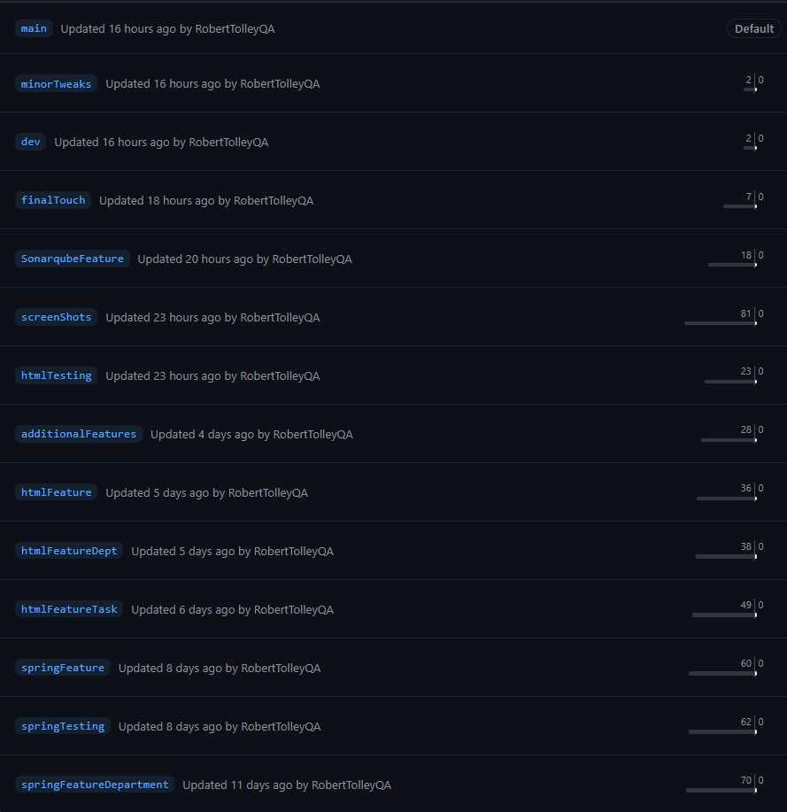

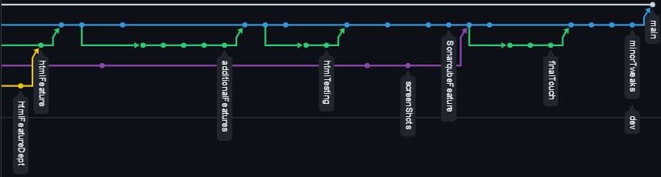
Version Control
Notes:
For version control began this whole project off by creating a git repository. as I was working on seperate features I would create new branches, and within those branches create even more for specific branch features I was working on.
Whenever these features were completed they would be merged up as far as they needed to be but no further than the dev branch which would act as the current snapshot I was working on.

Slide 9
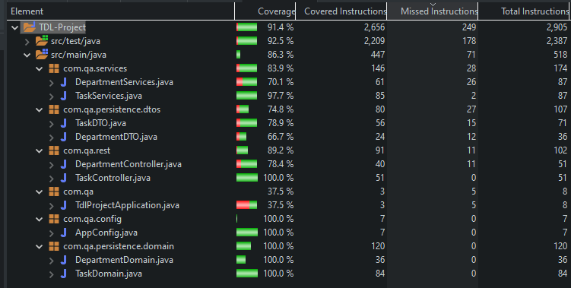
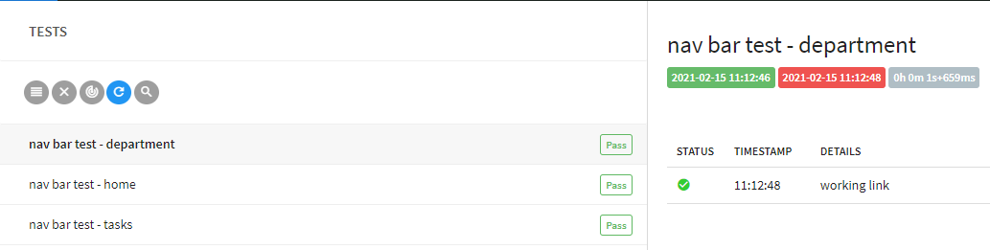
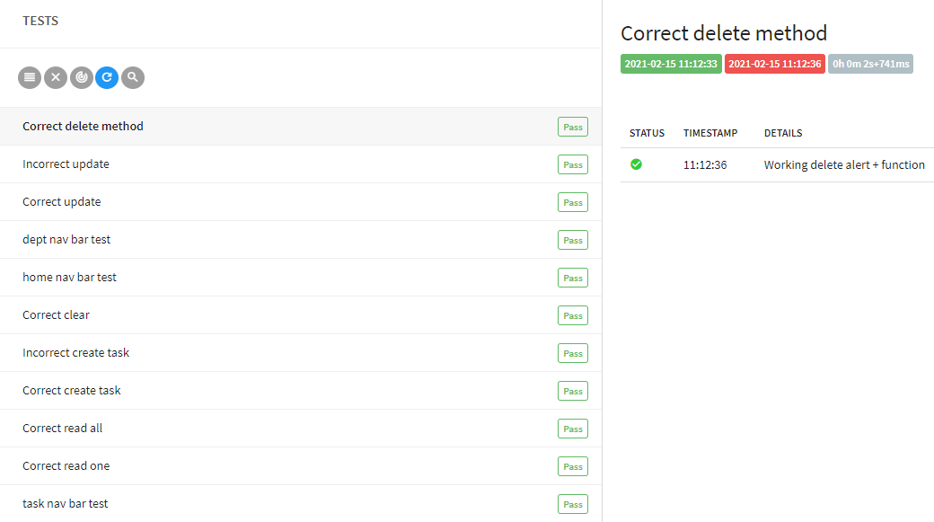
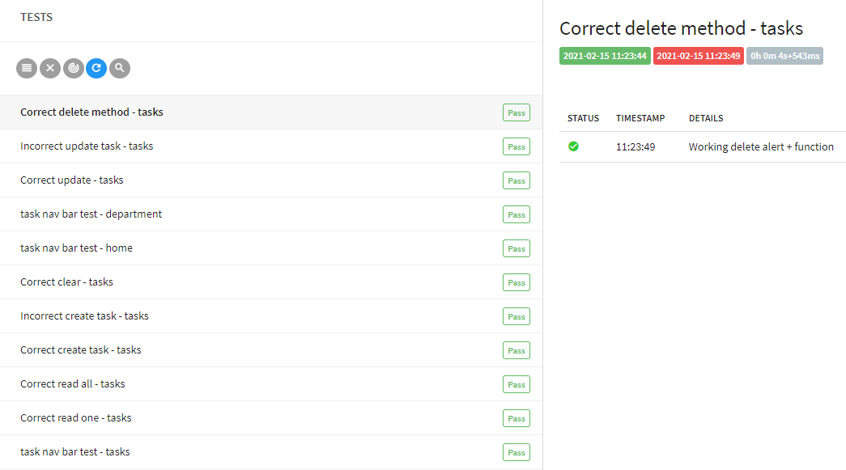
Testing
86% Coverage
Unit & Integration tests successful
Full automated testing
Index page
Task page
Department page
Notes:
I was able to achieve 86% coverage with my unit and intergration tests, this was done via junit and mockito
On the right you can see my automated testing which was done via selenium this has 100% pass rate for a large range of potential user interactions for each of the 3 pages, 1 being the index, the second being the tasks page and the third being the department page.

Slide 10
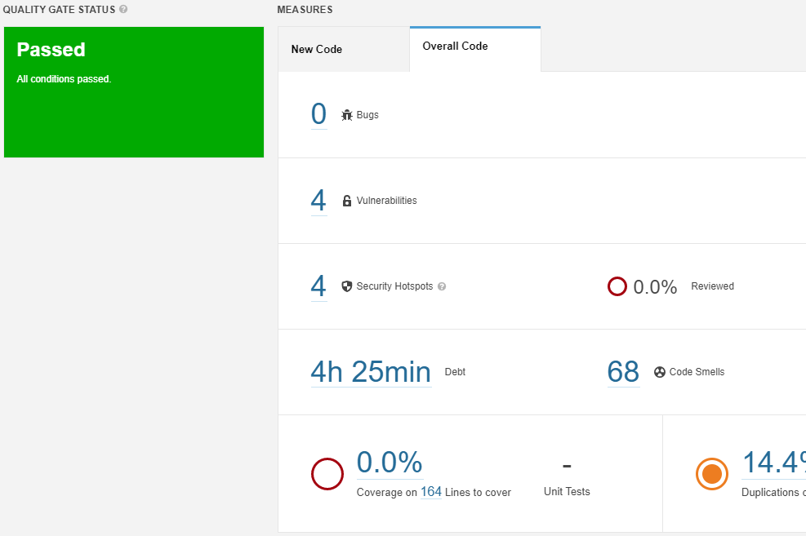
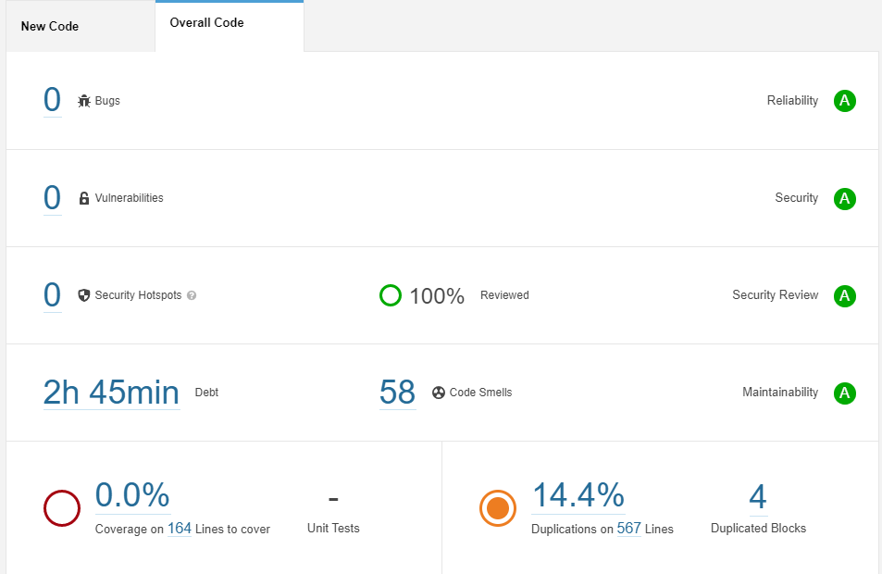
Sonarqube
Notes:
Once I was coming towards the end of all of my java script within spring, I used sonarqube to evaulate my code, this provided me with a few weakness which I looked into and solved, in the end receiving 3 A's for my code.

Slide 11
Demonstration
User stories:
1. Create a department
2. Create a task and assign a department

Slide 12
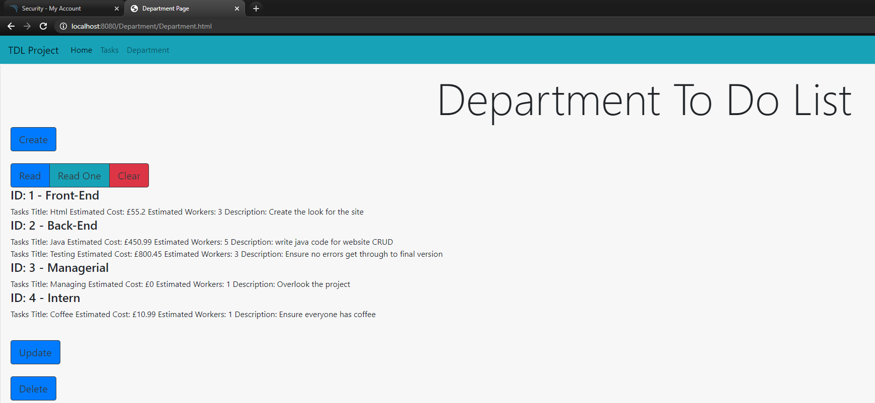

Example
Notes:
So here is what it would look like if there was a few more tasks and a few more departments already implemented into the database, at the top you can see departments group together tasks that have been assigned the same department ID

Slide 13
My review:
Sprint:
MVP completed
Effective route taken
Clear MoSCoW methodology
Available time for additional tweaks to be added
Changes:
Provide more detail to user stories
Create a new sprint for additional features
Notes:
I believe I was able to achieve a completed minimum viable product, the rroute I took to do these seemed effective and I was able to use the rating system to focus on some tasks more than others. By the end of the mvp I still has some addition time to provide some quality of life adjustments for the project.
The only changes think I could make would be to provide more detail to the user stories when creating the sprints as well as creating some new stories when I had the time to work on additional features, as I believe I could have got more done if I had planned it.

Slide 14
Conclusion
Project success – MVP completed
Able to utilise all new technology provided to me
General code etiquette has improved
Comfortable with html and javascript language
Notes:
So to conclude. I believe the project has been a success, the mvp was delivered. I was able to utilize all the new technology that was provided to me, Throughout working on my project I have been improving my code etiquette and general techniques through every language used, and I also feel comfortable now with these two new languages I have learnt as I was able to implement them both successfully.

Slide 15
Thank you for listening Questions?

